Slide 1
Oil Wealth and democratic survival
Supervisor: Dr. Benjamin B. Smith
Junior fellow: Maki shimada (political science senior)

Slide 2
Research question
Whether Oil Induces or Prevents Regime Changes, Especially in Democracies
Does Oil Really Make States Prone to Autocracies as It Is Widely Believed?
Is “Resource Curse” True?
The Type of Parameter Measured:
- Oil Income per Capita
- Regime Types

Slide 3
Significance
Highly Measured and Debated Issue
New Perspective in the Study of Oil Wealth and Regime Types
Body of Literature
Resource Wealth as Rent Leverage: Rethinking the Oil-Stability Nexus
Resource Wealth and Political Regimes: How Solid a Link After 40 Years of Research?
Oil Wealth and Regime Survival in the Developing World, 1960-1999
Blessing the Curse? Oil Wealth and Democratic Stability
Does Oil Hinder Democracy?
Oil and Autocratic Survival

Slide 4
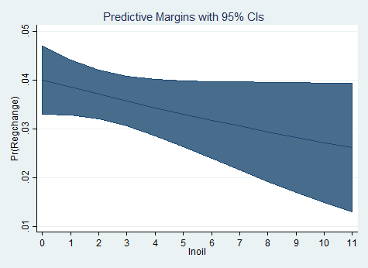
Graphs/charts
This is the global relationship between oil wealth and the likelihood of democratic breakdown. An increase of 9% or so lowers the risk by 3-4%

Slide 5
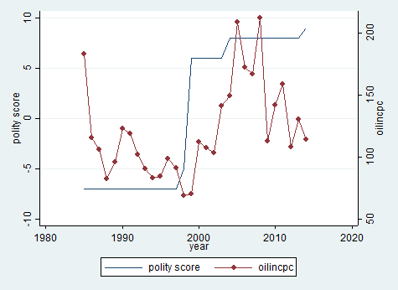
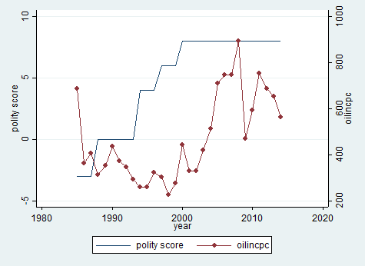
Oil income and democratization in Indonesia and Mexico, 1985-2014
In both cases oil income has grown along with democratic consolidation

Slide 6
Findings & implications
Oil Wealth Significantly Reduces the Chances of Democratic Breakdown
Higher Spending on Social Policies, Less Use of Coercive Force
Higher Political Stability, Less Likelihood of Collapse
Indicators for Peace and Socio-Economic Development
Further Research in Depth
New International Relations, Policy Implications

Slide 7
Methods
My Task: Data Collection
Methodologies:
- Extraction of polity scores and oil income per capita (from Ross + Mahdavi) for Indonesia and Mexico during the period of 1985-2014
- Finding out which states have moved to 6 or higher on Polity score since 1970
Takeaway:
Counterfactual evidence of resource curse, Exposure to experts’ research methods

